Slide 1
Computer Graphics and Game Systems
DAC415
<Student Name>
<Jack Hill>
<Student Name>
<Student Name>

Slide 2
Student 1 Asset & Texture List

Slide 3
Student 1 3D Models

Slide 4
Student 1 Textures & Materials

Slide 5
Student 1 Section In-Game Screenshots

Slide 6
Student 2 Asset & Texture List

Slide 7
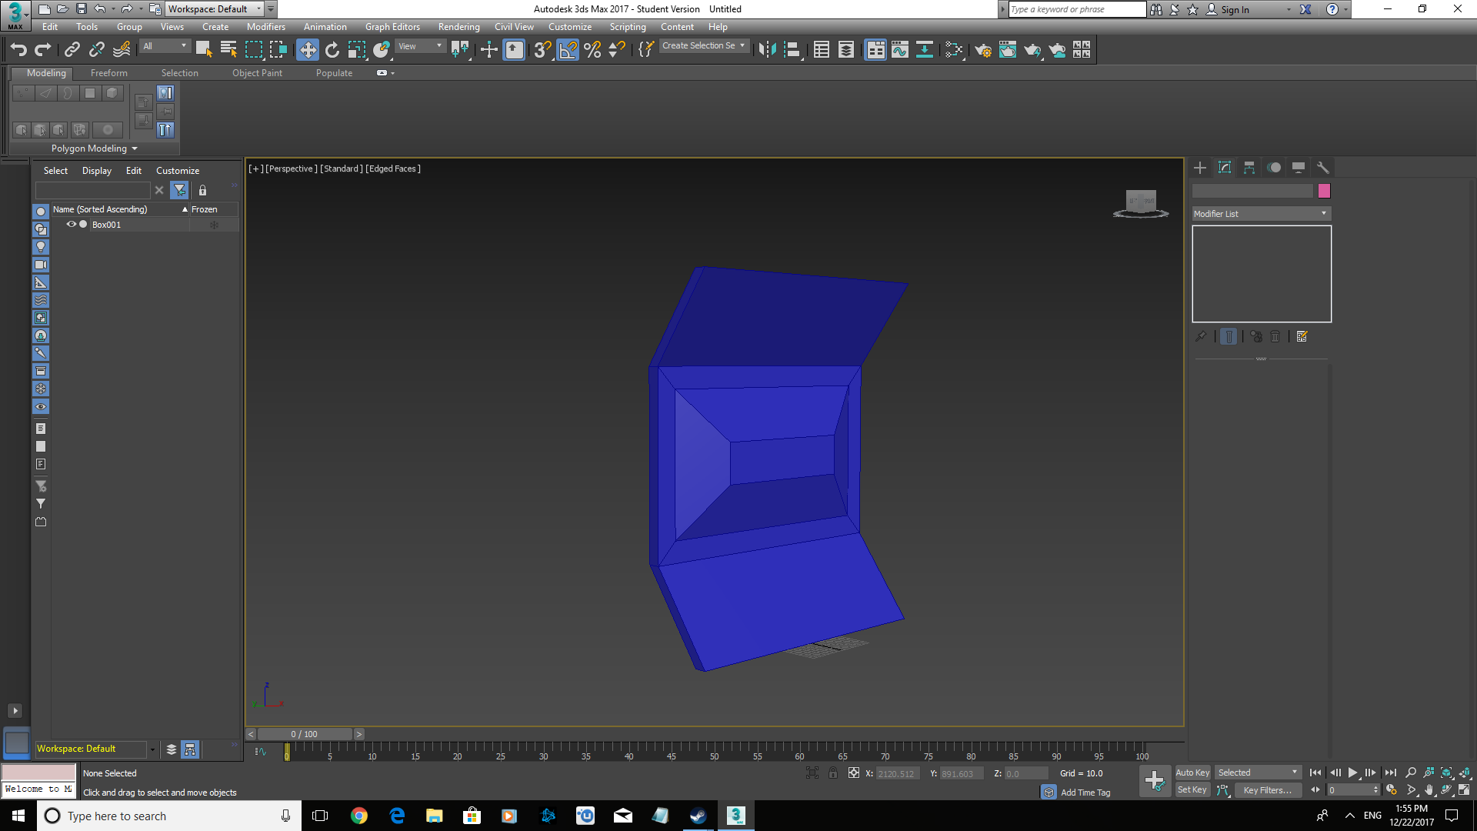
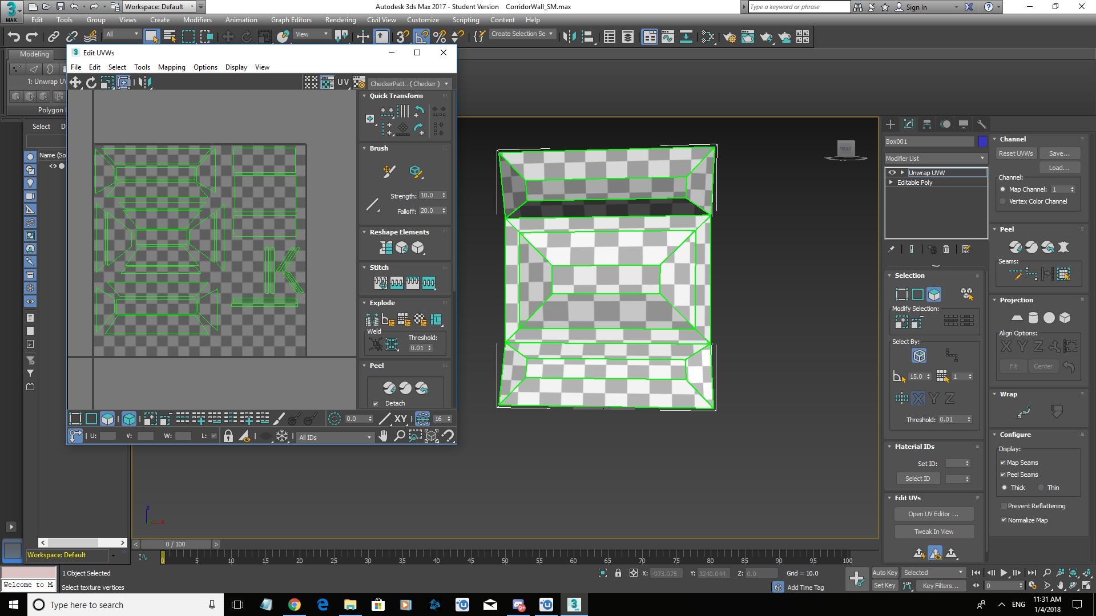
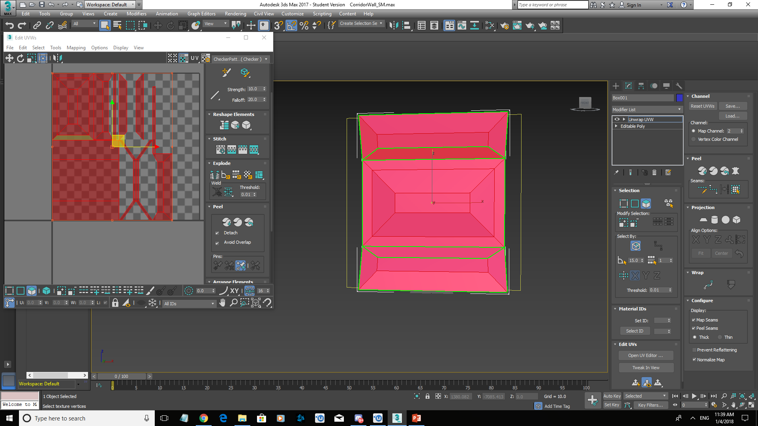
Student 2 3D Models

Slide 8
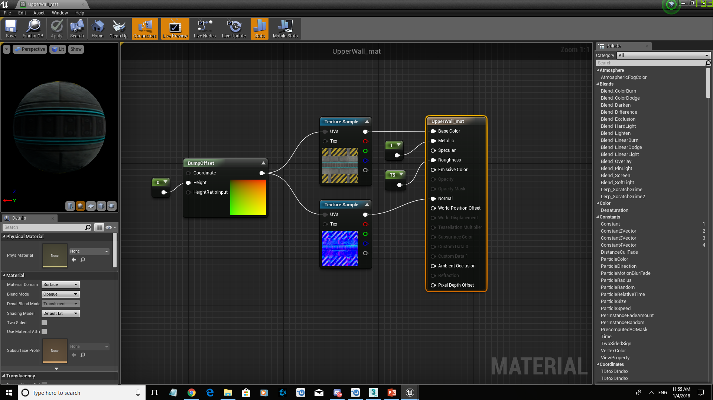
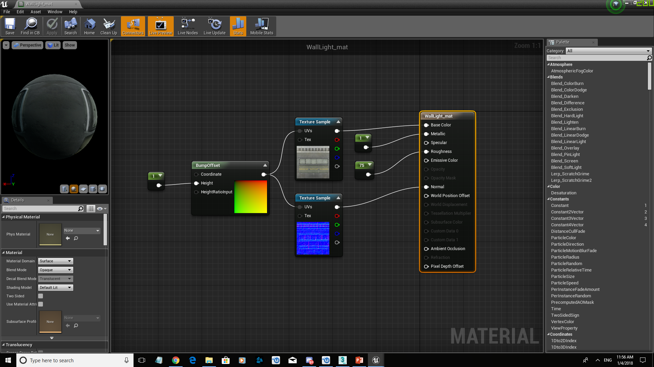
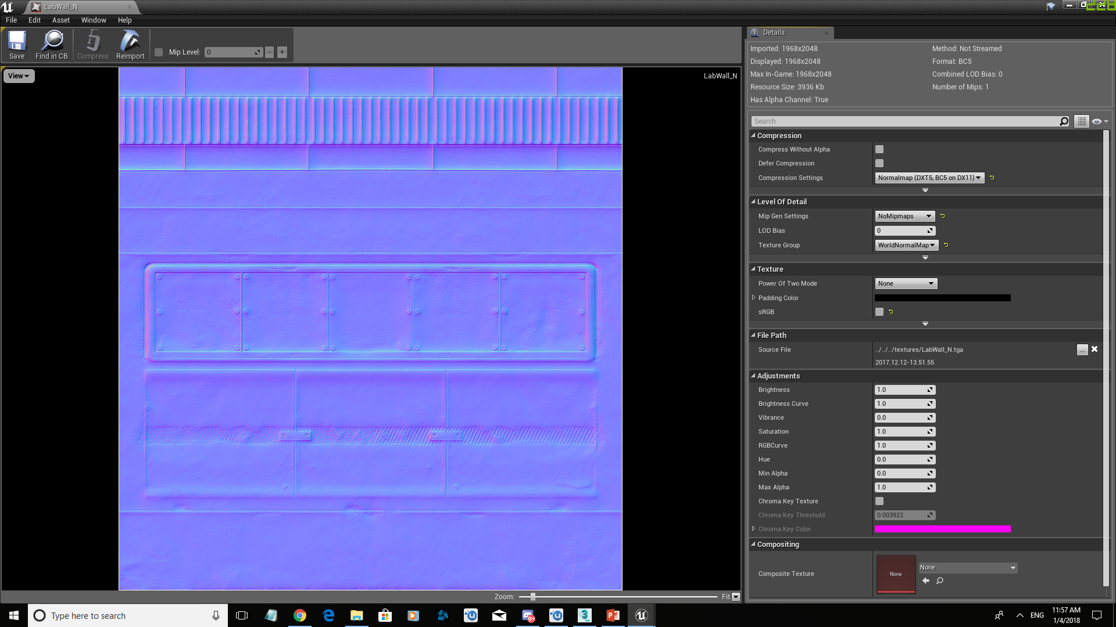
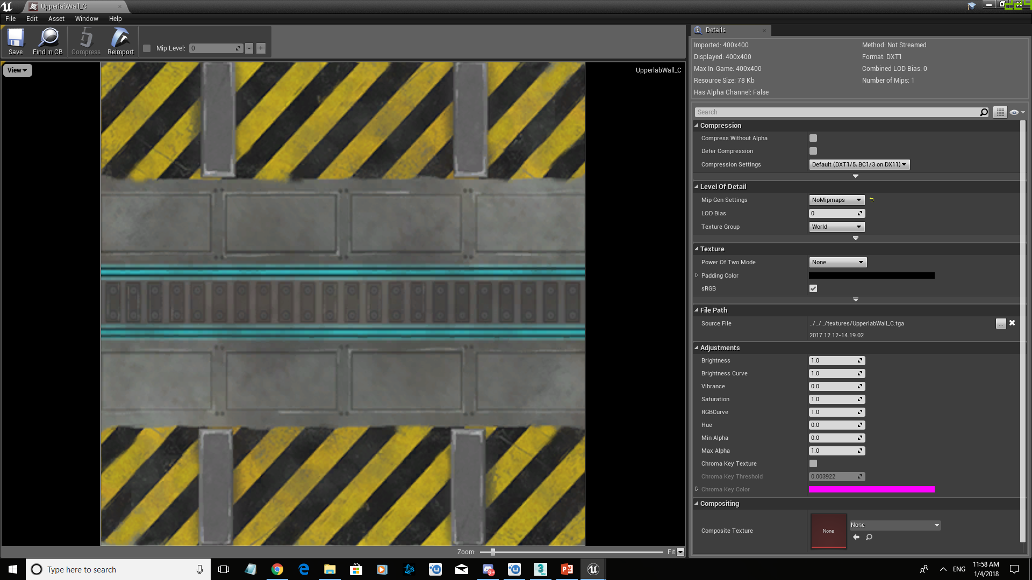
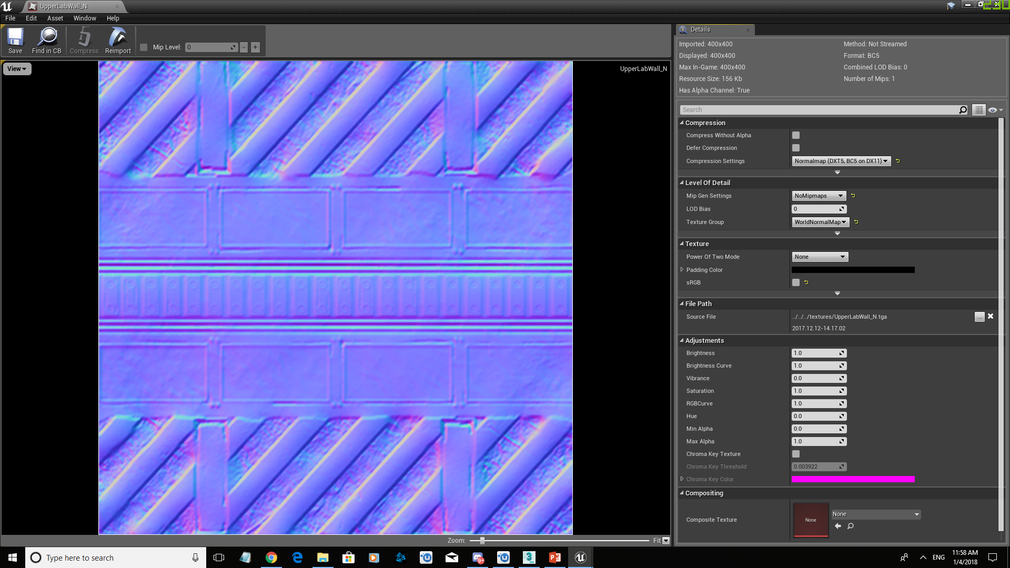
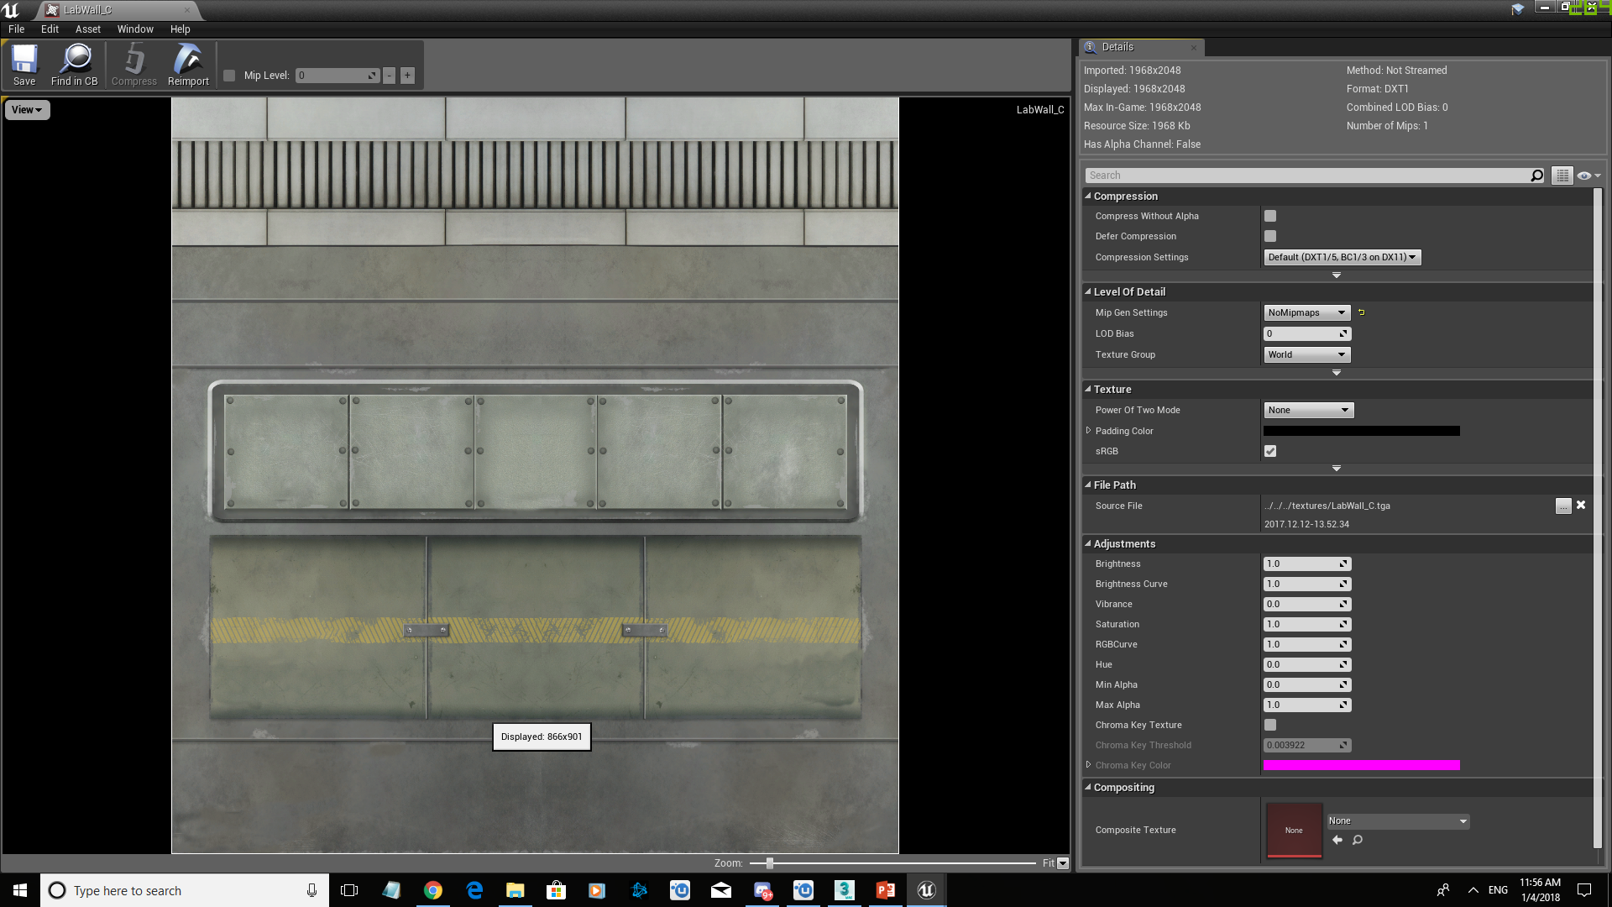
Student 2 Textures & Materials

Slide 9
Student 2 Section In-Game Screenshots

Slide 10
Student 3 Asset & Texture List

Slide 11
Student 3 3D Models

Slide 12
Student 3 Textures & Materials

Slide 13
Student 3 Section In-Game Screenshots

Slide 14
Student 4 Asset & Texture List

Slide 15
Student 4 3D Models

Slide 16
Student 4 Textures & Materials

Slide 17
Student 4 Section In-Game Screenshots

